Slide 1

Not just a semester at the beach: Professionalizing your study abroad experience on your resume
Emily Marchese and Alison Albright, Nazareth College

Slide 2
Resumes: General Information
-Start writing/updating once return
-reflective assignments
-brainstorming sessions/mind mapping
-Match the job description
-Sections: Education, Internship, Experience, Skills
-Action verbs list

Slide 3
Resume Formatting Tips
Make it scannable – what is the information you want to jump out?
Most important information first
What sets you apart?
  Hint: language skills, international experience
Keep it clean – think highlights, not grocery list
Looking light? Meaningful fillers
  - Relevant Coursework
  - Awards, trainings
  - Software, skills

Slide 4
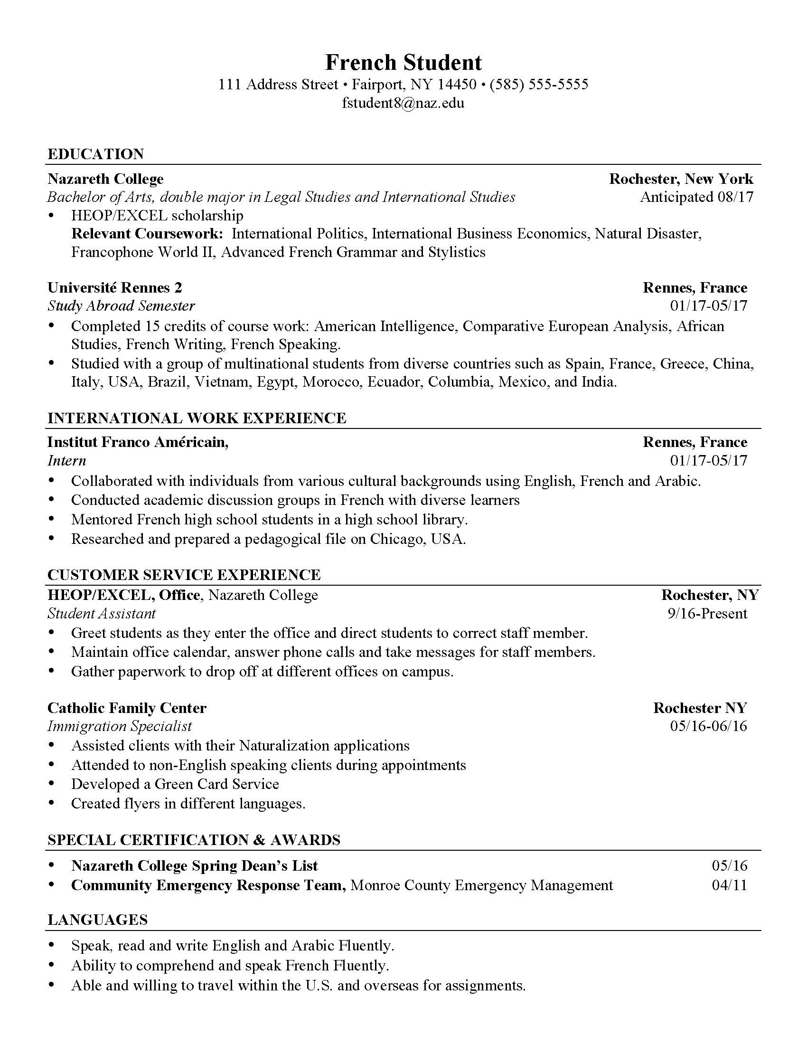

Slide 5
Example 1: Study Abroad without additional experience
Education Section:
List Study Abroad as institution with dates and location
Can Include Coursework
List scholarships and awards attached to the experience
International Experience Section:
Discuss competencies engaged with during your experience
Mimic language of job description
Example: Ben Travelling

Slide 6
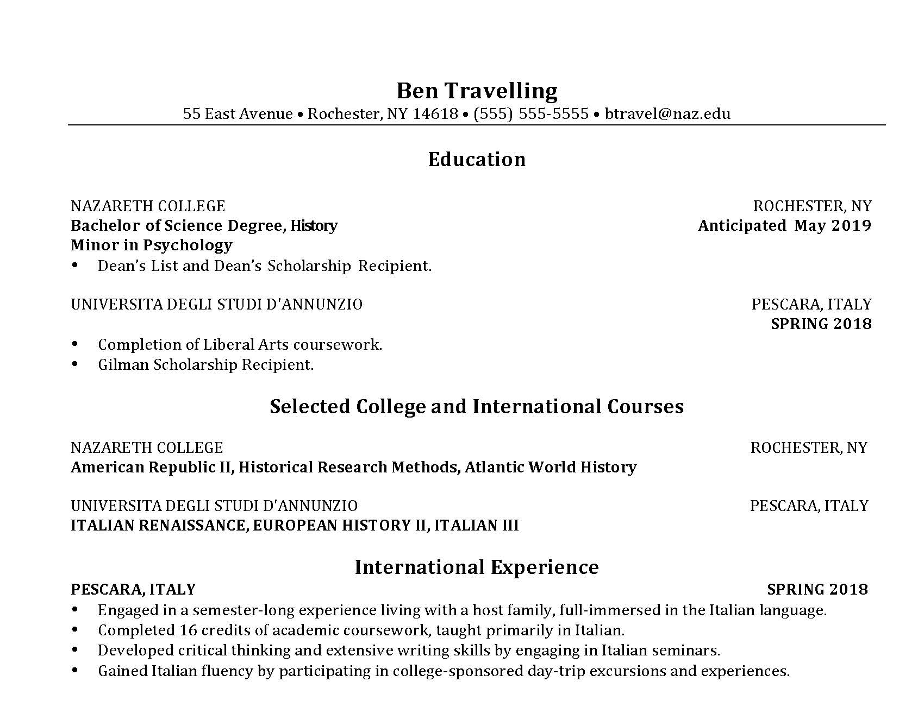

Slide 7
Example 2-Study abroad with Internship
Study Abroad in “Education Section”
Specific “International Work Experience” section, use those competencies.

Slide 9
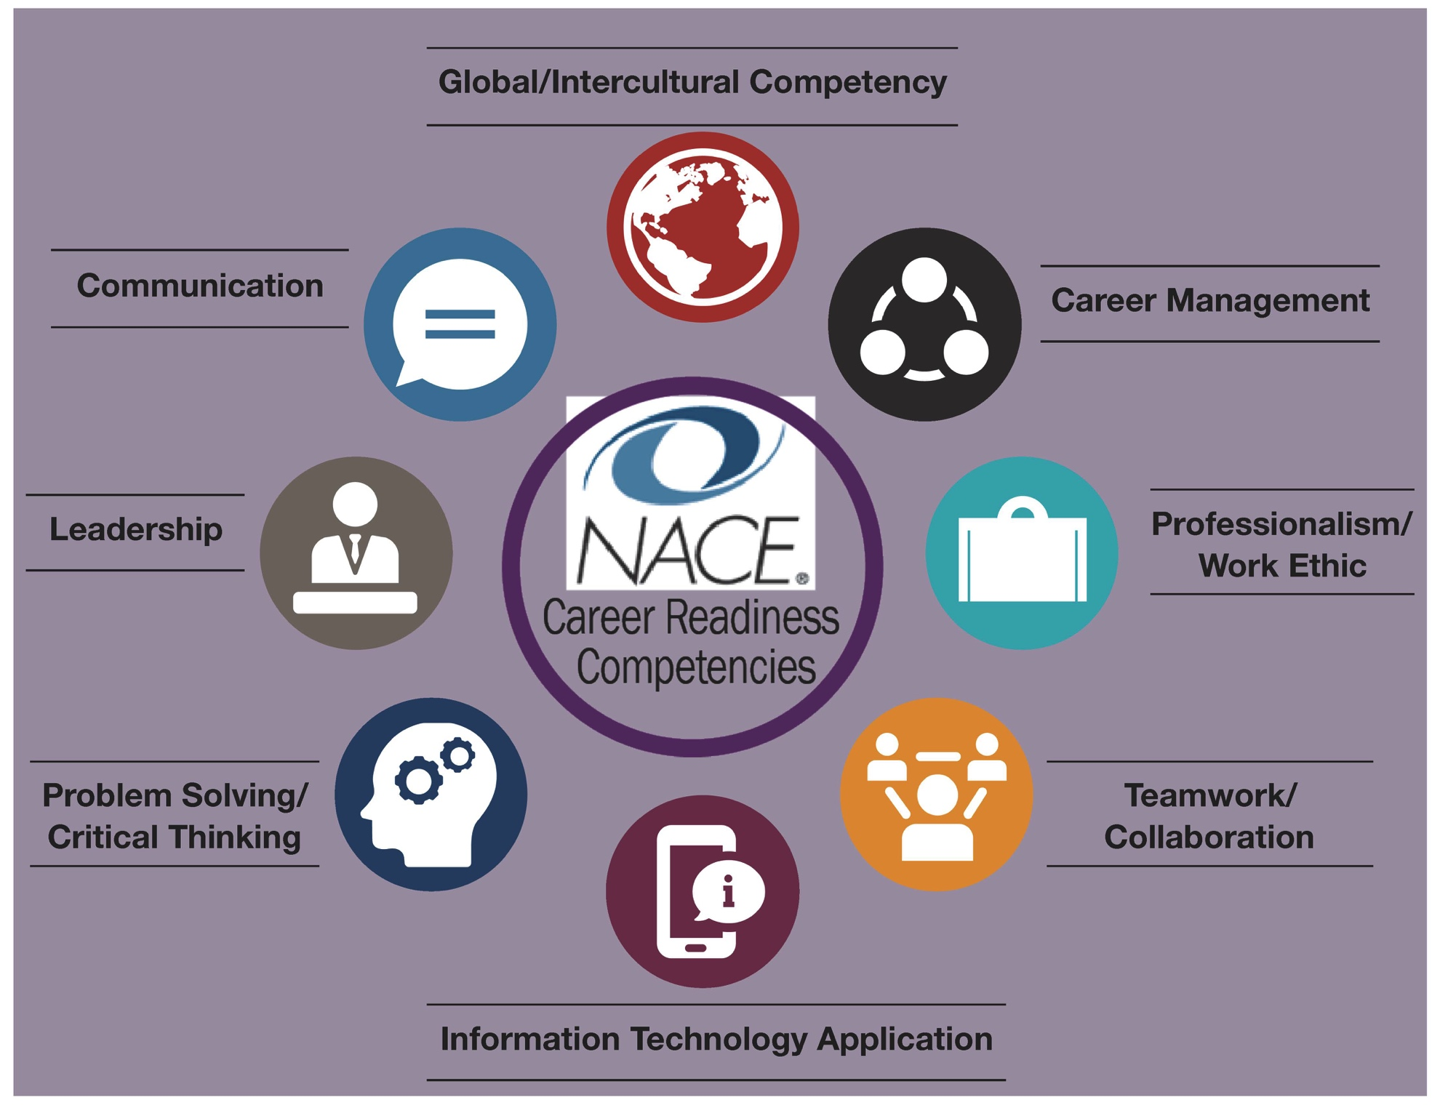

Slide 10
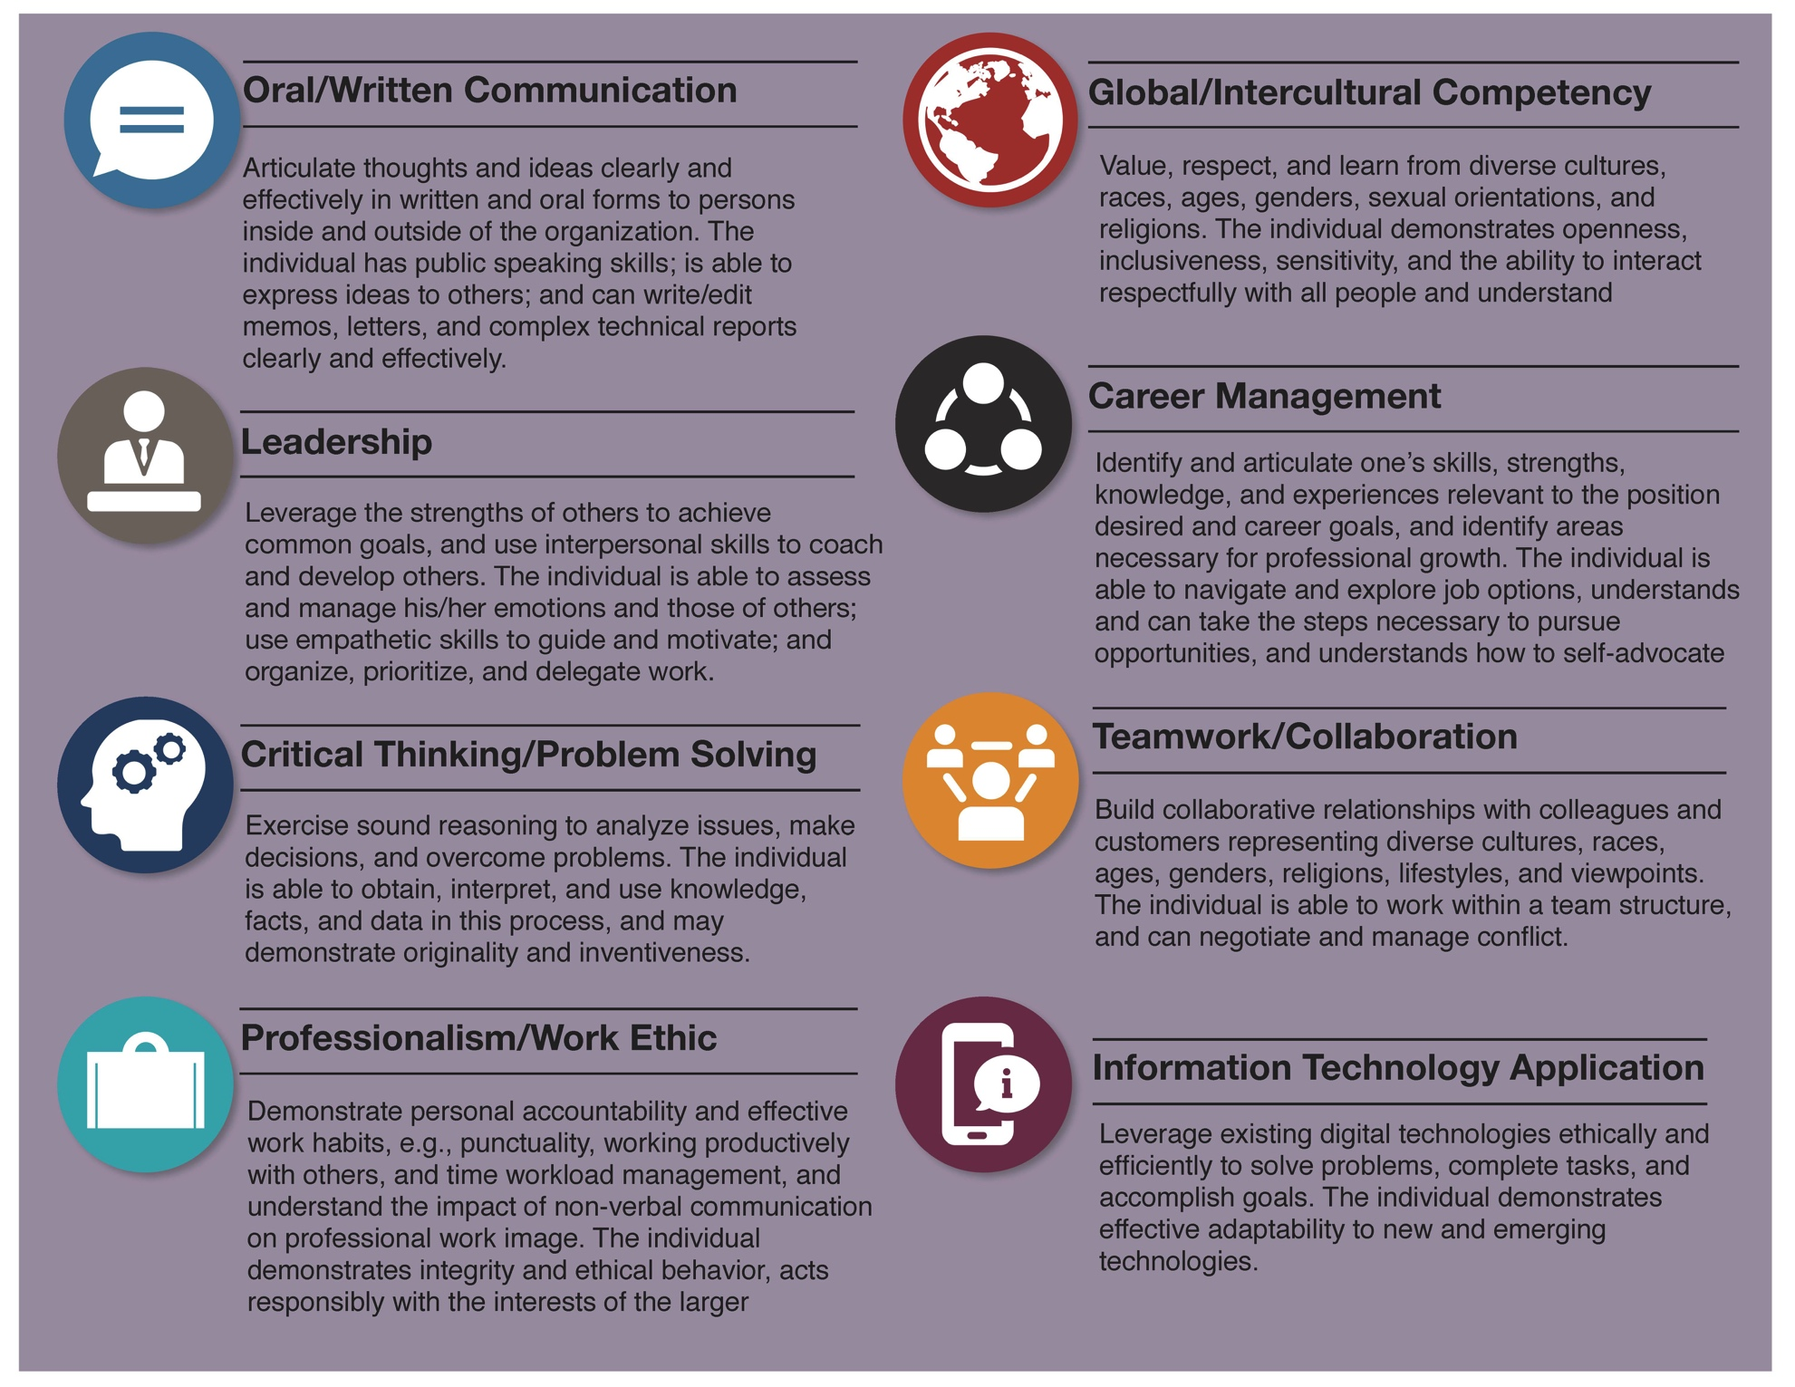

Slide 11
Bullet Points
Summarize the skills you have, not what you’ve done
Itemize and specify your tasks
Quantify your actions
Describe what you learned
Credit your impact and contributions, even if you were a small part of a large undertaking

Slide 12
Good to Great
GOOD: Handled social media
GREAT: Developed and marketed organization’s Facebook fan page, gaining more than 500 fans in eight weeks.
GOOD: Worked in client sales.
GREAT: Developed and maintained relationships with 100+ clients utilizing excellent interpersonal skills.
GOOD: Coordinated community project.
GREAT: Initiated an innovative community service project to aid 20 elementary students in developing social skills.

Slide 13
Further development in cover letter
-Introduce yourself, intrigue them to read the resume, what unique aspects do you offer as a study abroad student
-Use job description language
-Resist the urge to download a sample from your career services office and use the same language! Make it your own!
-If an item gets only one line on your resume, then develop more in your cover letter

Slide 14
Good to great – Integrating Competencies in your Bullet Points
Using your handouts, brainstorm 1-2 bullet points for each of the NACE Competencies
Remember to be specific (be great, not good)
Think about what sets you apart
Notes:
5 minutes to get started – finish this up on your own time! Make an appointment with your career services to review your resume!

Slide 15
Contact Information
Emily Marchese
Assistant Director for Global Experiential Learning
Nazareth College
emarche0@naz.edu
Alison Albright
  Career Coach
  Nazareth College
  aalbrig9@naz.edu

